Slide 1


Slide 2

Background
Instructor: John Garcia
I teach advanced data analytics at the University of North Texas
Project: We will use R to fit three classification model to a highly imbalanced dataset:
1
Decision Tree: Uses a tree-like model of decisions to arrive at a classification prediction.
2
Naïve Bayes classifier: Uses Bayes’ theorem to use probability to arrive at a classification prediction.
3
Linear Discriminant Analysis: Finds a linear combination of features that is used to separate the classes.

Slide 3
We will use R to…..
Explore
Perform Exploratory Data Analysis
Split Data
Randomly split our data into a training / test set
Balance
Apply synthetic balancing techniques to balance the highly imbalanced training dataset
Train
Train our three classification models.
Evaluate
Evaluate their performance on the test data set.
3

Slide 4






Why Balance our Dataset?
Dataset: 99 Horses…..1 Zebra
Prediction Algorithm
All Horses
100 Horses
99% Accuracy

Slide 5
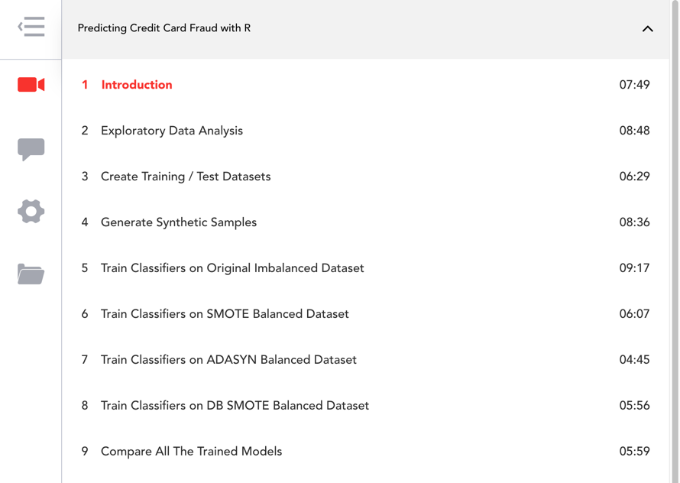
Navigation

Slide 6
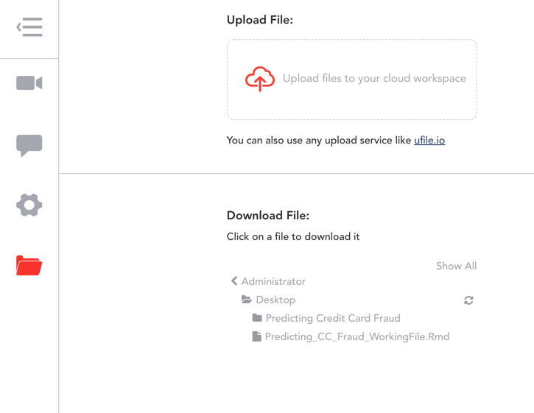
Navigation

Slide 7
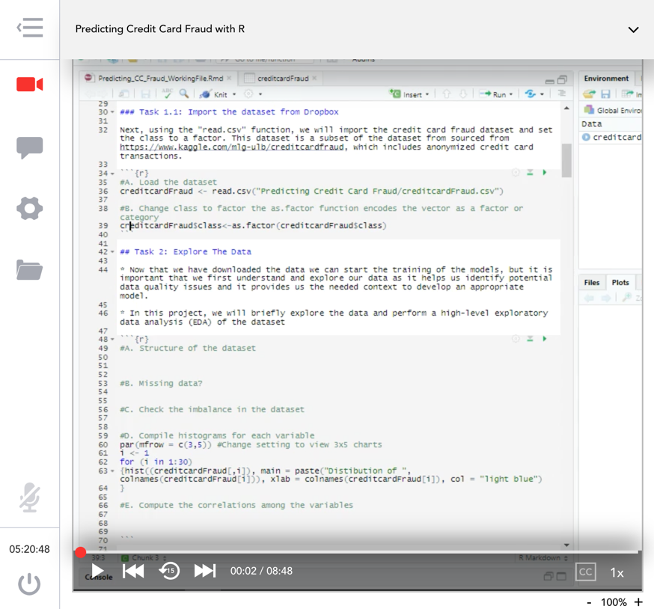
Navigation

